Slide 1
Analyzing the NFL Draft
CISC 6325 Final Project
by Henry Gorelick

Slide 2
Overview
Background
Issues
Claim
Process
Outcome
Future Work

Slide 3
Background
Annual NFL Draft Rules
Each team receives 1 pick per round
32 picks per round (+ ~50 compensatory picks)
7 rounds
~254 total picks
Order – reverse standings of previous season
Teams may pick eligible players to join their team in the upcoming season

Slide 4
Issues
A player who underperforms relative to his draft position is labeled a “Bust”
1
Busts lose games and get people fired
2
A good draft is about finding good value
3
Boom or Bust

Slide 5
Claim
Collegiate performance does not correlate to NFL success
Jamarcus Russell, QB
2007 Round 1, Pick 1
Ryan Leaf, QB
1998 Round 1, Pick 2
Trent Richardson, RB
2012 Round 1, Pick 3
Mark Sanchez, QB
2009 Round1, Pick 5
Steals
Busts
Tom Brady, QB
2000 Round 6, Pick 199
Antonio Brown, WR
2010 Round 6, Pick 195
Richard Sherman, CB
2011 Round 5, Pick 154
Alvin Kamara, RB
2017 Round 3, Pick 67

Slide 6
Data Collection and Processing
Gathering Data
Python Packages
Preprocessing
Removing players with little to no stats
Recalculating percetage stats
SQLite3
BeautifulSoup
Selenium ChromeDriver
www.Pro-Football-Reference.com
Data Source
www.sports-reference.com/cfb/

Slide 7
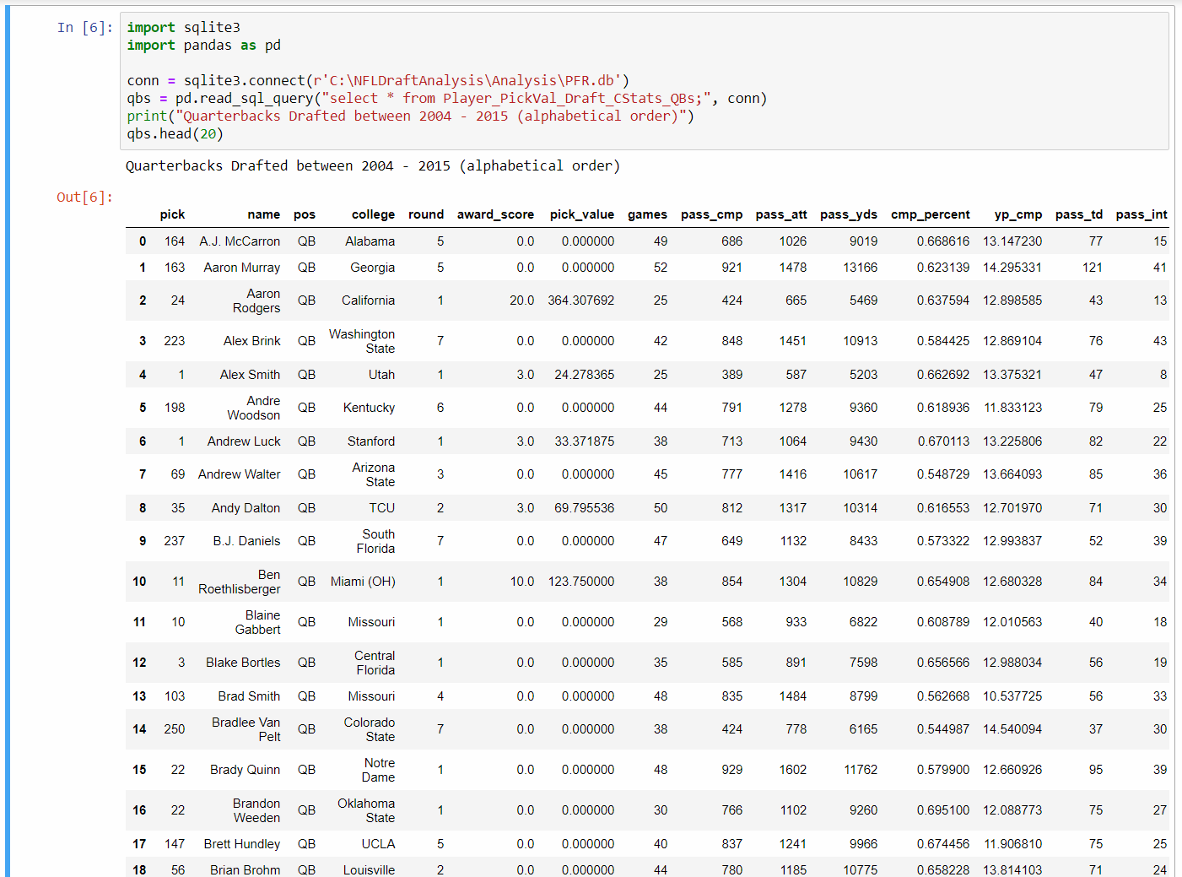
Sample Data Results

Slide 8
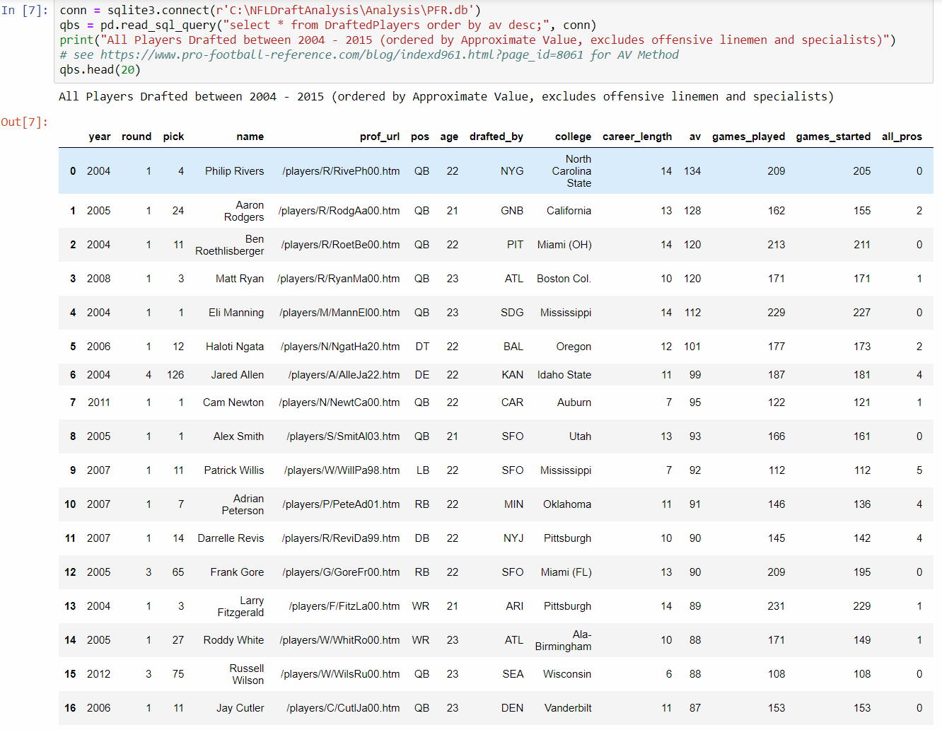
Sample Data Results

Slide 9

Outcome
Despite the small sample size, results suggest that collegiate performance does not correlate to draft position

Slide 10
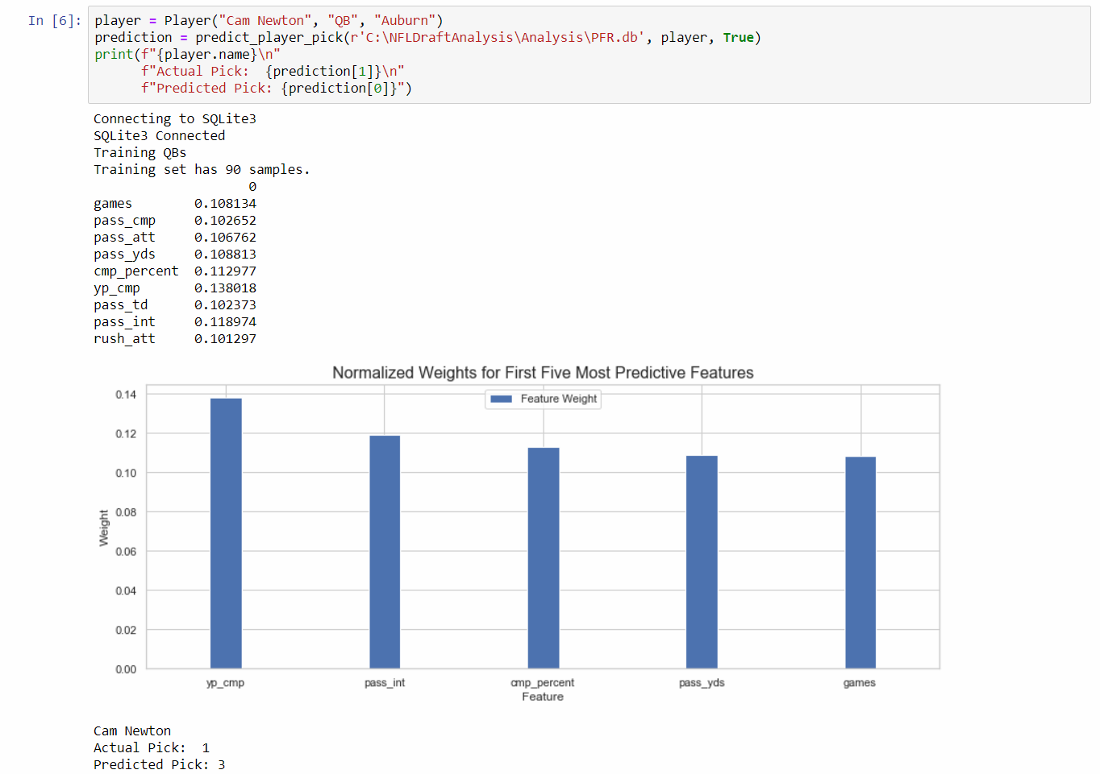
Prediction 1 Cam Newton

Slide 11
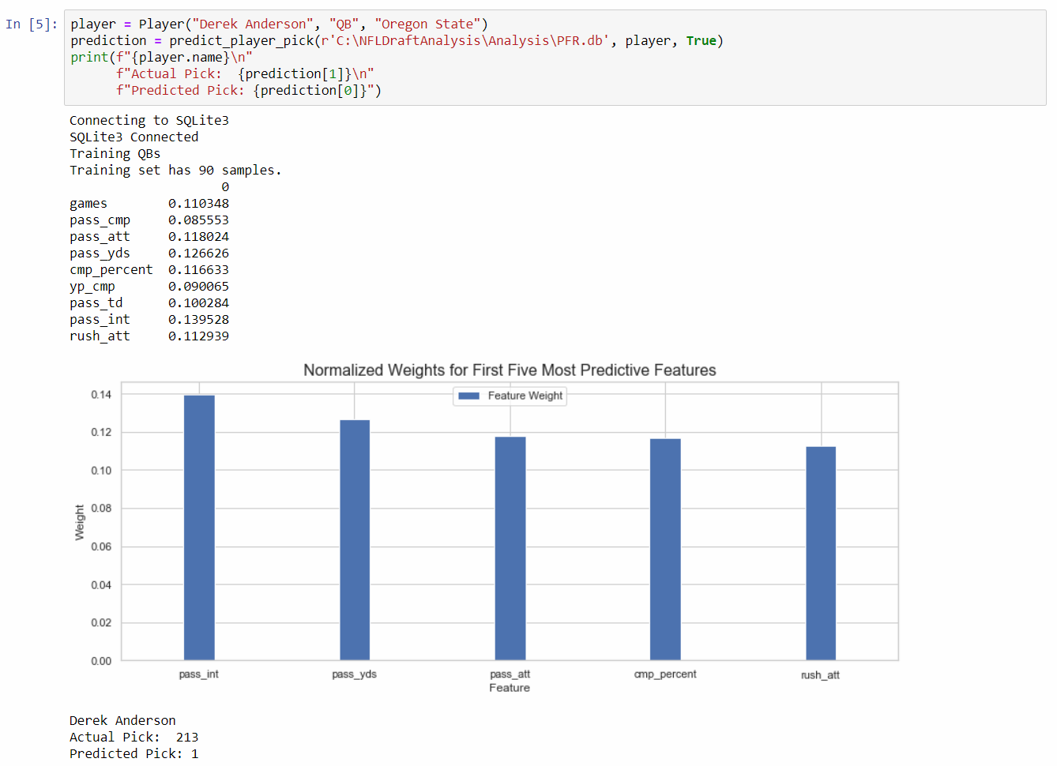
Prediction 2 Derek Anderson

Slide 12
Future Work
Include NFL Combine Data in prediction model
I predict this will massively affect the results, and make my prediction model accurate instead of intentionally inaccurate.
Use Collegiate Production to Predict NFL Production
Include Players Drafted After 2015
Reverse Predictions
Predict collegiate stats based on NFL production

